Slide 1

₋-..
--.-.-.,,
............ _,.,,,

Slide 2
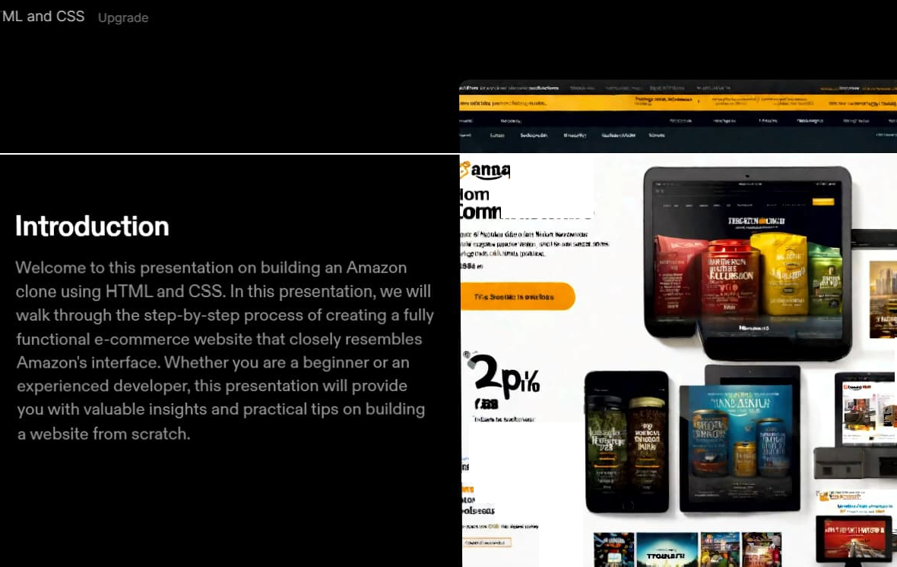
on
eeftion ,
trntori1ro
luuo1111olalllin
n·1nntlnK1lo
11,uo\'ordtl u L'J'.liJICICJn(i
lt

Slide 3
HTML Basics
HTML stands for HyperText Markup Language and is the standard markup language used to create web pages
.
HTML consists of a series of elements which are used to define the structure and content of a web page.
Basic HTML Structure
Every HTML document should have the following basic structure:
<!DOCTYPE html><html><head><title>Page Title</title></head><body><h1>Heading1</h1><p>Paragraph text</p>
</body></html>
The <!DOCTYPE html> declaration is used to indicate that the document is an HTML5 document. The <html> element is the root element of an HTML page.
The <head> element contains meta information about the document, such as the title of the page.
The <title> element is used to specify the title of the document, which is displayed in the browser's title bar or tab. The <body> element contains the visible content of the document, such as headings, paragraphs, and images.

Slide 4
⁻⁻·⁻⁻-.⁻·.⁻.-⁻..⁻-.⁻.-⁻.:.-.⁼--.·^{.-}·-⁼--⁼-:­::·

Slide 5
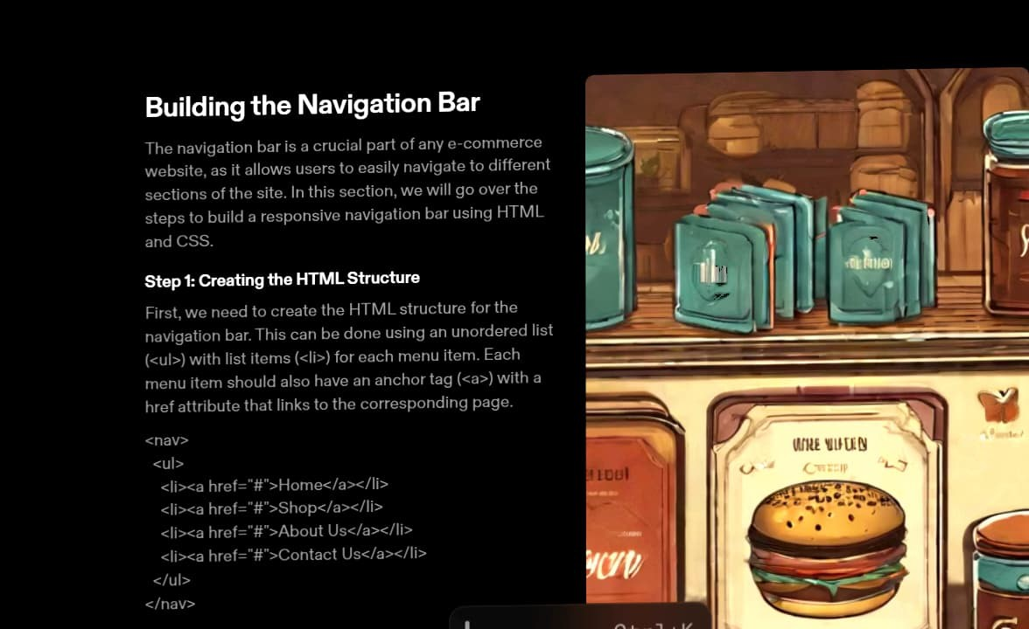

Slide 6
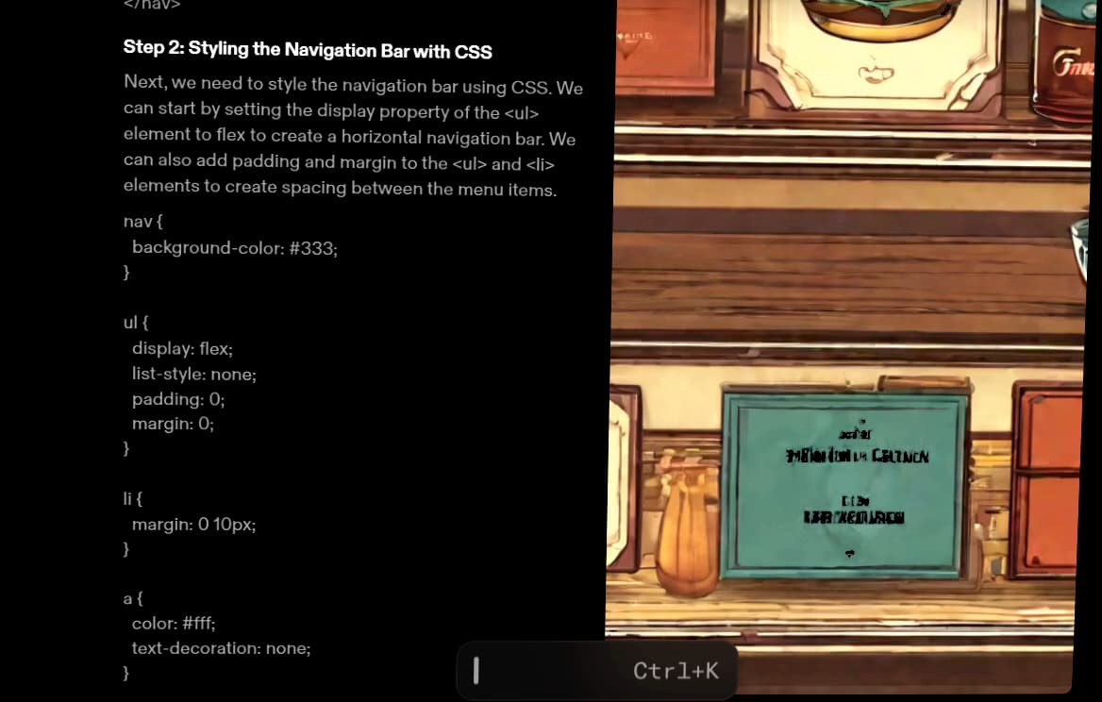

Slide 7
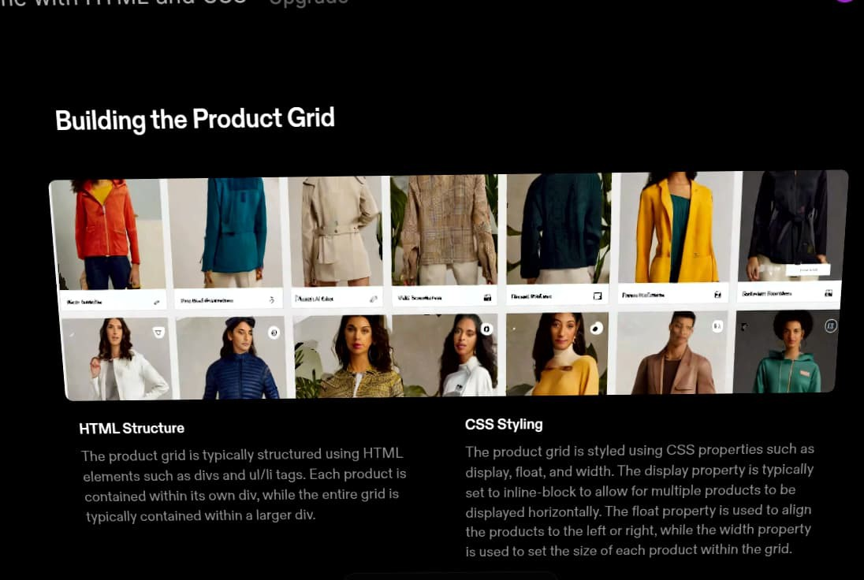

Slide 8
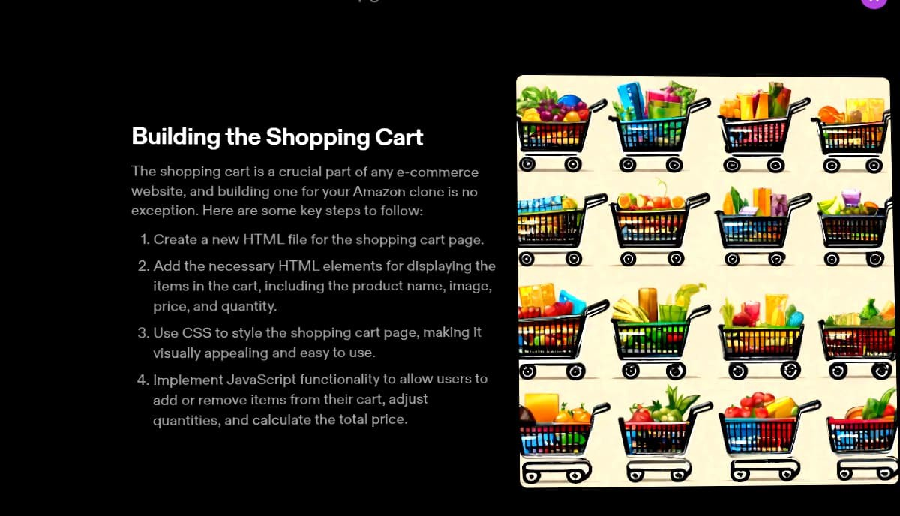

Slide 9
